Slide 1
Week 6’s Final Project
Adewale Adetule
California Intercontinental University
MGT 542-Leadership Development In Organization
Dr. Archana Joshi
December 18th, 2022, 11:59 PST
Notes:
Click to add notes.

Slide 2
Jeff Bezos: The Transformation Leader

Slide 3
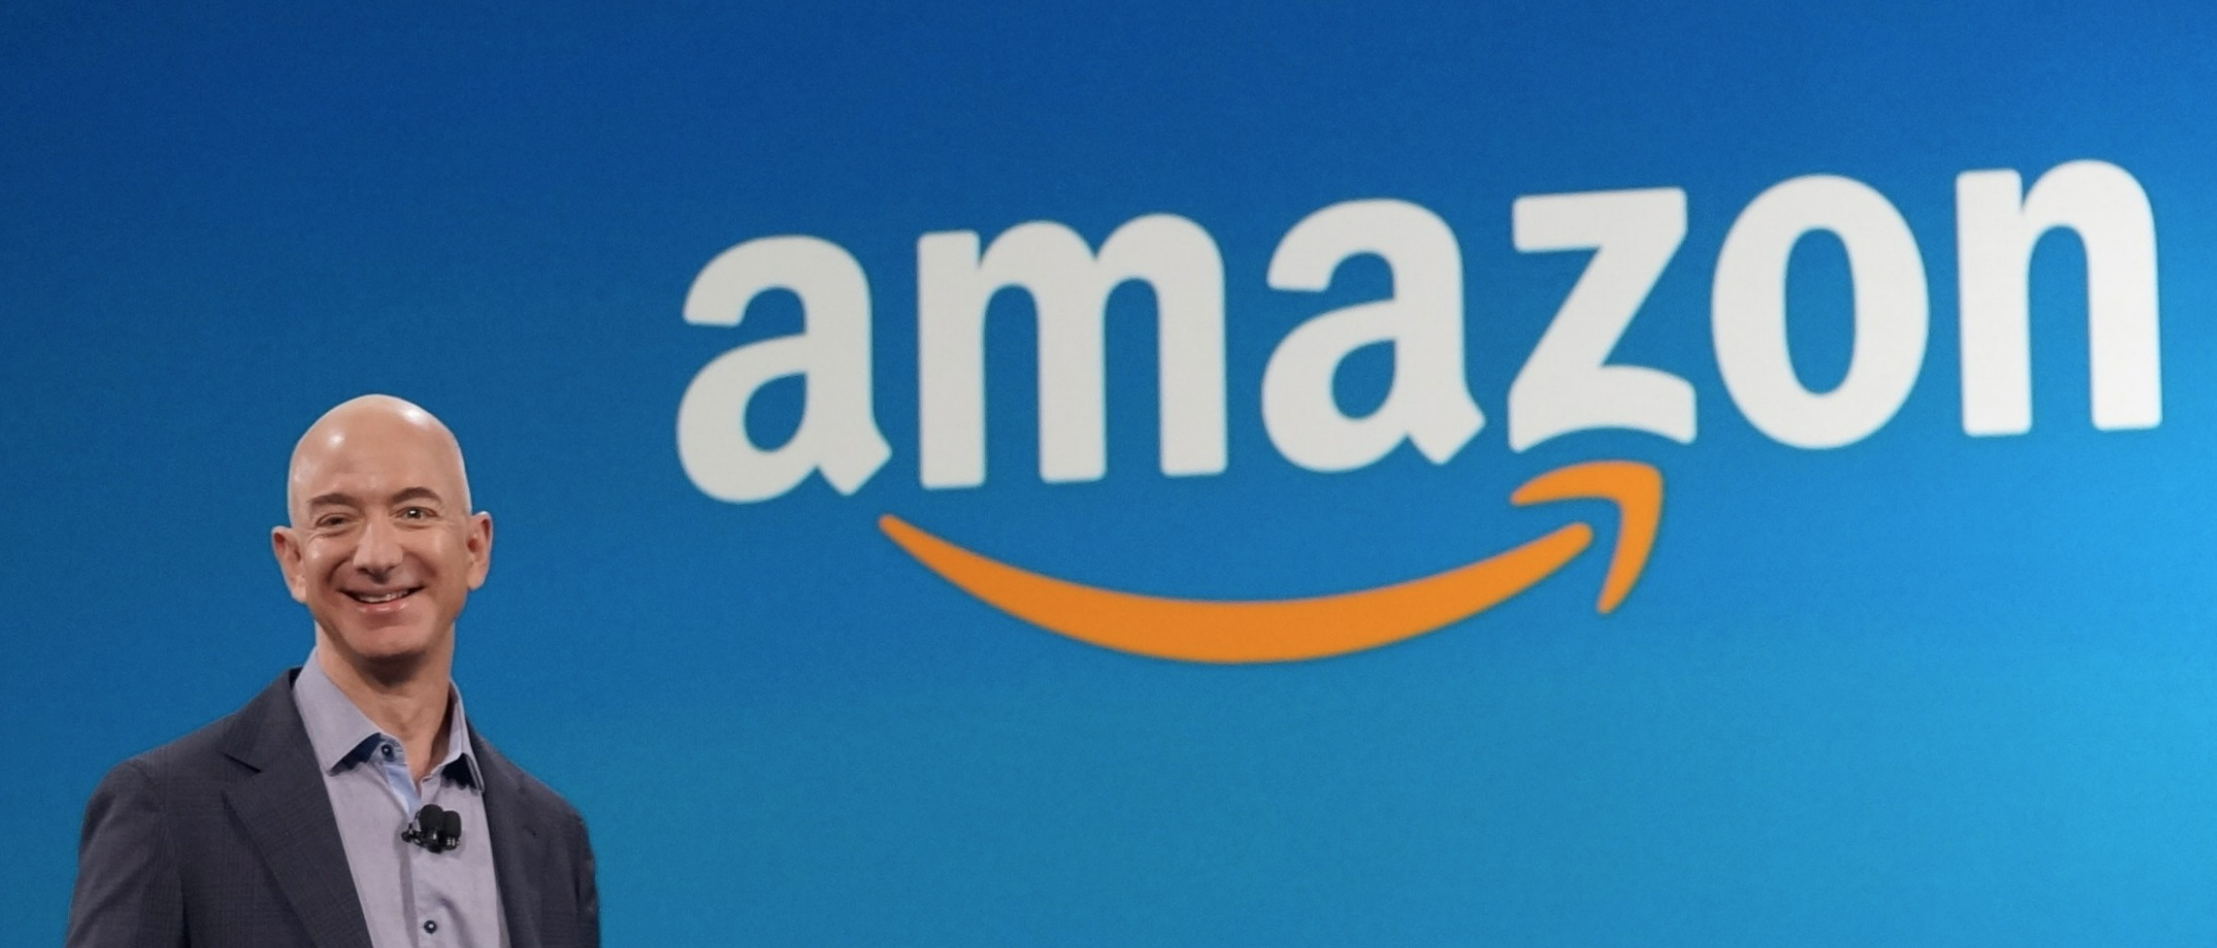
Jeff Bezos: The Person
Born in 1964.
Started his company from his garage.
Founded Amazon.com in 1994
Pioneered and Revolutionized E-commerce
Amazon.com is the largest retailer on the internet.
Notes:
One of the most creative business leaders in the world is Jeff Bezos, founder and executive chairman of Amazon and Blue Origin, a space company that supports public spaceflight.
Many business leaders are trying to adopt his tactics in the wake of his success with Amazon in the e-commerce sector.
One cannot deny that Bezos has sound moral values that others can imitate, especially given his current net worth of $194 billion.

Slide 4
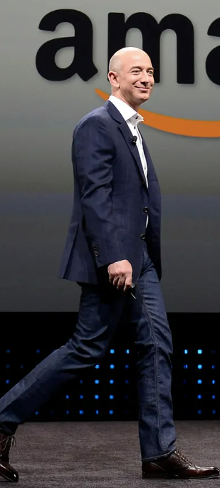
Jeff Bezos: The Leader
A beacon of modern leadership
Has a clear Vision of Better Customer Service
An innovative entrepreneur
Media proprietor
Space traveler
Inspirational
Notes:
Young business leaders have much to learn about leadership from Jeff Bezos.
The distinguishing qualities that have made Bezos one of the wealthiest in the world are his leadership techniques, mannerisms, and philosophies.

Slide 5
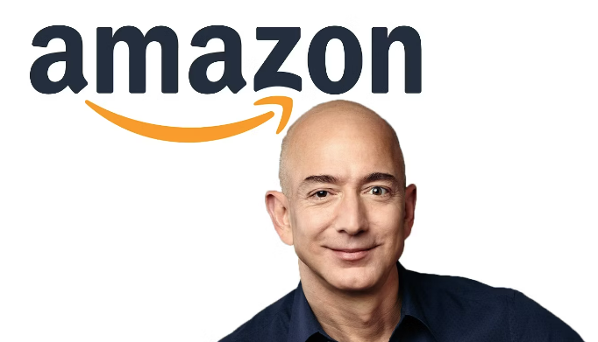
Jeff Bezos: Leadership Style
He is Quasi transformational.
Advocate Common Culture
Has a Compelling Vision
Intellectual Stimulation
Individual consideration
He is Quasi transactional.
Legitimate authority
Clear tasks and objectives
Notes:
Transformational: He holds a clear vision of better customer services and has led Amazon to become one the best company for customer satisfaction in America. He is also known for his wild and unique ideas.
Employee work rate is closely measured with anyone falling behind provided training. Anyone who fails to meet up after may be asked to go. He is known for being straightforward with his employees and demanding high standards.
Transformational: Pros & Cons
In his pursuit of innovation, he is not afraid to encounter failure, which could lead to negative consequences.
He believes in complete open communication, which can lead to large-scale disagreements.
Transactional: Pros & Cons
Employee work rate is closely measured with anyone falling behind provided training. Anyone who fails to meet up after may be asked to go. He is known for being straightforward with his employees and demanding high standards.
There has been a report of a lack of empathy by employees.
There has been some report of bad culture leading to a huge turnover.

Slide 6
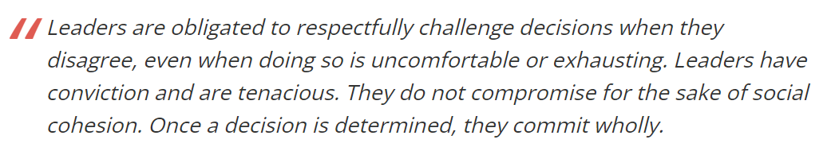
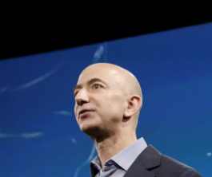
Jeff Bezos: Conflict Management Style
Genuinely Disagree
Express candidly
Build Trust with the teams
Get consensus and commitment
Notes:
"Disagree and Commit" changes how we disagree with our colleagues, teams, and bosses. You are responsible for arguing and persuading others when you disagree with something on Amazon. It is about using your expertise or unique perspective to discuss your case respectfully and successfully.
You must commit anyway if you state your case but cannot persuade others. Amazon has zero tolerance for blaming others or sabotaging their projects. Disagree if necessary, but then sincerely commit to success.

Slide 7
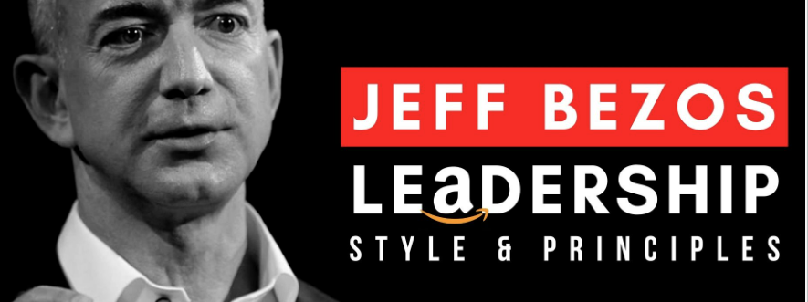
Jeff Bezos: Leadership principles
Embrace Failure
Customer Always Comes First
Ownership
Keep innovating
Notes:
Embrace Failure: Jeff Bezos has a novel approach to accepting, normalizing, and embracing failure despite the disappointment and devastation typically associated with it. Bezos stated, "One area where I think we are especially distinctive is a failure," in a letter to Amazon shareholders. We are the best place to fail because failure and invention are inextricably linked. You must experiment to develop something new; it is not an experiment if you already know it will work.
Customer Always Comes First: Since the beginning, Jeff Bezos has been clear about his desire for Amazon to be completely customer-focused. A business strategy known as "customer centricity" places a strong emphasis on the interactions that customers have with brands. To increase repeat business, it is essential to foster strong customer loyalty.
Ownership: Amazon has much loftier goals than short-term profits or margins. They consider the long-term and do not sacrifice long-term value for short-term gains. They act on behalf of the entire organization, not just their team. They never say, "That's not my job."
Innovate: Leaders expect and demand innovation and invention from their teams and constantly look for ways to simplify. They are externally aware, seek new ideas from everywhere, and are not constrained by the phrase "not invented here." We accept that we may be misunderstood for a long time when we try new things.

Slide 8
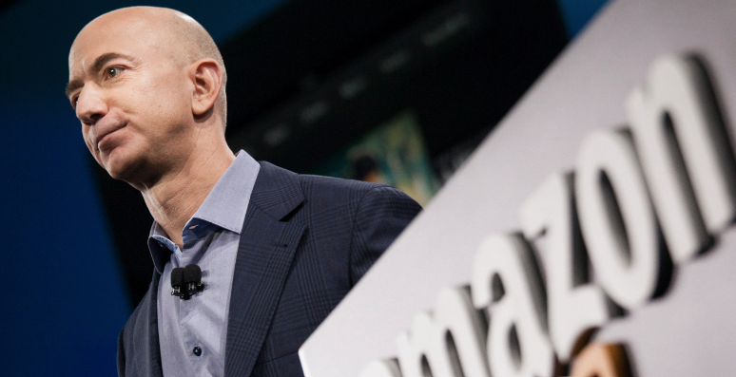
Jeff Bezos: Influence Tactics
Legitimating tactics
Convincing a person to comply
Push tactic
Limited Effectiveness
Exchange tactics
Influence by Reward or Benefits
Push tactic
Moderately Effective
Notes:
The leader gives the team member who isn't performing at their best emotional support by being helpful and constructive.

Slide 9
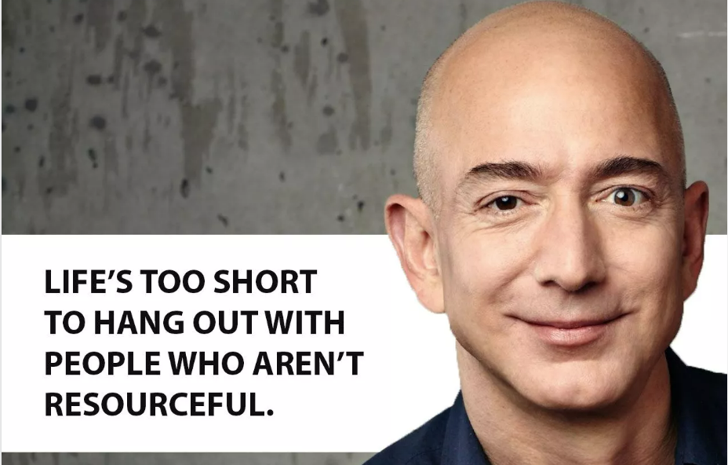
Jeff Bezos: Teamwork
The Two Pizza Rule
Long-term success
Be stubborn on vision and flexible on the details
Legitimate and Strong Leadership
Clear communication
Notes:
The Two Pizza Rule: No working group should be larger than the number of people that two pizzas can feed. In other words, you're losing effectiveness if your team is more significant than 5-7 people.
Long-term success: Patience, adaptability, and a willingness to take a more challenging road are baked into the few rules he’s strict about.
Be stubborn on vision and flexible on the details: Being firm about where you want to go is an essential part of the strategy. On the other hand, being strong about how you get it is unwise.
Strong Leadership to motivate followers.

Slide 10
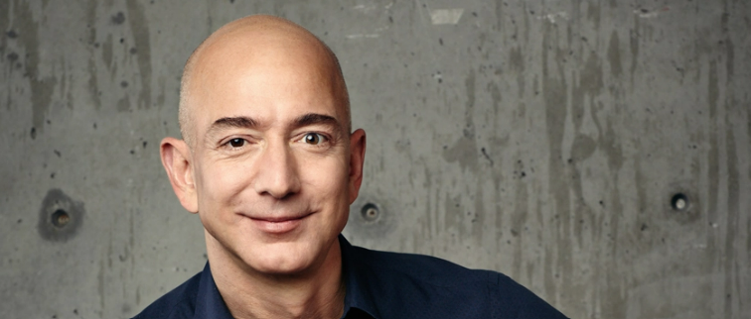
Jeff Bezos: Recommendations
Lack of Workforce diversity
Influence Tactics
Compensation Disparity
Notes:
Lack of Workforce diversity: Bezos Jeff is not diverse enough, given that most of its growth is in its domestic market.
Influence Tactics: Not completely effective and need to consider at least one inspirational appeal, consultation and rational appeal tactics.
Compensation Disparity: The highest-paid employees are the technology and the engineering staff. He needs to be more inclusive in their payment. The engineers are more dedicated to the job than low-income persons who handle delivery and handling.

Slide 11


Slide 12
References
DuBrin, A. J. (2015). Leadership: Research Findings, Practice, and Skills (8th ed.). Cengage Learning US. https://online.vitalsource.com/books/9781305465084
Matthews, B.L., Harbin, J., Daigle, J., 2018. The New York Times Versus Amazon: Is Jeff Bezos’ head still in the clouds? J. Organ. Psychol. 18.
Newark, D., 2018. Leadership and the logic of absurdity. Acad. Manage. Rev. 43, 198–216.

